Slide 1

Disability Etiquette
Version: October 2019

Slide 2
Review of Disability
A person who has a physical, mental, emotional or intellectual impairment that substantially limits one or more major life activities such as:
Walking
Standing
Seeing
Speaking
Hearing
Breathing
Self Care
Learning
and WORKING

Slide 3
Hidden or Invisible Disabilities
ADHD
Anxiety disorders
Asthma
Learning disabilities
TBI
Epilepsy
Diabetes
Cystic Fibrosis
Chronic Pain

Slide 4
The Basics
Ask before you help
People with disabilities want to be independent
If you are asked to help, ask how
Avoid touching a person’s equipment
Wheelchair
Scooter
Cane
Remember “person first” language

Slide 5
Wheelchair Users
Wheelchair users have different disabilities and varying abilities
Some may get out of their chairs and walk for short distances
Don’t lean over a person in a wheelchair
Don’t push or touch a person’s wheelchair
It’s part of their personal space
Keep work areas clear and accessible
Be aware of reach limits
Place items within grasp
Lower service counters

Slide 6
Wheelchair Users (continued)
When talking to a person in a wheelchair:
Whenever possible, grab a chair and sit at his/her level
If that’s not possible, stand at a slight distance so that eye contact is not difficult
Some individuals have limited use of their hands, wrists or arms
Be prepared to assist (upon request) with reaching, grasping, lifting, opening doors, operating vending machines
If you don’t know – ask
Treat everyone the same

Slide 7
People who are Blind
Be prepared to offer assistance when asked
Identify yourself before making contact or before speaking
Be prepared to describe the environment
Do not grab the person’s arm or hand
Offer your arm if he or she requests guidance
It’s OK to ask!
If the person has a guide dog, walk on the opposite side from the dog
As you are walking, describe hazards

Slide 8

People who are Deaf
Individuals who are Deaf often communicate using American Sign Language (ASL)
Entirely different language
Speech reading (lip reading) is often difficult for ASL speakers
The best way to communicate complex information is through a certified Sign Language Interpreter
Always look at the person, NOT the Interpreter!
For simple communication, writing back and forth can work
As always, ask what the person prefers!

Slide 9



People who are Hard of Hearing
English is most often the primary language
May have some hearing, but use other tools:
Amplification such as hearing aids, telephone amplification etc
Speech/lip reading
Most people who experience hearing loss as adults do not use ASL
Always face the person and speak clearly
Do not shout
Do not cover your mouth (to help with speech reading)

Slide 10
People with Speech Disabilities
Give the person your full attention
Don’t interrupt or finish sentences
If you don’t understand, it’s OK to ask for repetition
If you’re not sure you understand, repeat for verification
If you still don’t understand, it’s OK to ask a person to write it down , or you can suggest other options
A quiet environment can be helpful

Slide 11
Hidden Disabilities
Not all disabilities are apparent

Slide 12
People with Psychiatric Disabilities or Mental Illness
Many different kinds of Mental Illness
Different for each person
Different coping strategies
Stress can affect a person’s ability to function
Treat each person as an individual
If a person is struggling, be calm and supportive
Is there a support person the person can call?
HELLO
my name is
HELLO
Steve
my name is
Betty
HELLO
HELLO
my name is
my name is
William
Janice

Slide 13
Epilepsy and Seizure Disorders
If a person has a seizure, you cannot do anything to stop it. If he has fallen, be sure his head is protected and wait for the seizure to end.
When a seizure has ended, the person may feel disoriented and embarrassed. Try to ensure that he has privacy to collect himself.
Be aware that beepers and strobe lights can trigger seizures in some people.

Slide 14
People with Multiple Chemical Sensitivity and Respiratory Disabilities
Sensitivity to stale air and fumes
Cleaning products
Perfumes
Carpeting
Air fresheners
Request that staff that have contact with the public go easy on fragranced body-care products like cologne, hair spray, hand lotion, and after-shave.
Second-hand smoke can be particularly harmful to people with MCS or respiratory disabilities.

Slide 15
People with HIV & AIDS
People with HIV and AIDS are particularly susceptible to infection
If you have a respiratory infection or any other easily transmittable illness, be considerate of all your customers and employees and stay home, if possible.
You can’t catch HIV from casual contact such as shaking hands, so don’t be afraid of touching or being touched by a person with AIDS.
Many people with AIDS feel stigmatized. By simply greeting or shaking the person’s hand, you are letting him know that he is accepted. It will mean a lot to him.

Slide 16
People with Developmental Disabilities
Speak to the person in clear sentences, using simple words and concrete—rather than abstract—concepts. Help her understand a complex idea by breaking it down into smaller parts.
Don’t use baby talk or talk down to people who have developmental disabilities. Gauge the pace, complexity, and vocabulary of your speech according to theirs.
Remember that the person is an adult and, unless you are informed otherwise, can make her own decisions.
It can be difficult for people with developmental disabilities to make quick decisions. Be patient and allow the person to take their time.
Clear signage with pictograms can help a person who has developmental disabilities to find her way around a facility.
People with developmental disabilities often rely on routine and on the familiar to manage work and daily living. Be aware that a change in the environment or in a routine may require some attention and a period of adjustment.

Slide 17
People with Learning Disabilities
People with dyslexia or other reading disabilities have trouble reading written information. Give them verbal explanations and allow extra time for reading.
Because spoken information gets “scrambled” as he listens, a person who has a learning disability such as auditory processing disorder may need information demonstrated or in writing
Ask the person how you can best relay information. Be direct in your communication. A person with a learning disability may have trouble grasping subtleties.
It may be easier for the person to function in a quiet environment without distractions, such as a radio playing or people moving around

Slide 18
People with Traumatic Brain Injury (TBI)
Some of the factors that affect people with learning disabilities also apply to people with traumatic brain injury.
A person with a brain injury may have poor impulse control. The person may make inappropriate comments and may not understand social cues or “get” indications that she has offended someone.
A person with a brain injury may be unable to follow directions due to poor short-term memory or poor directional orientation.
The person may have trouble concentrating or organizing her thoughts, especially in an over-stimulating environment, like a crowded movie theater or transportation terminal.

Slide 19
People Who use Service Animals
Service Animals are a necessary accommodation
Need to modify “no animals” policy
Service animals take precedence over health codes
Do not touch or interact with the service animal
Services animals can be used for a variety of disabilities
Brain injury
Anxiety disorders
Seizure disorders
Low vision or blindness
Other

Slide 20
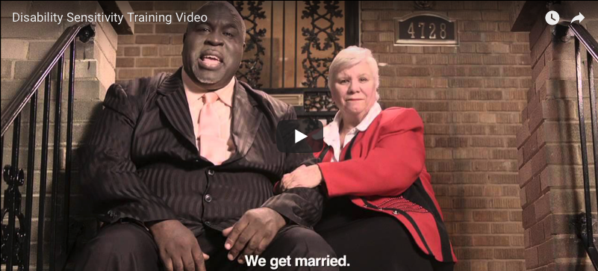
Disability Etiquette
Notes:
Let’s watch a video for a better understanding of how not to be #Awkward.
https://youtu.be/Gv1aDEFlXq8

Slide 21

Questions?
Zach Arter
Specialist
Nebraska VR
402-214-2847
zach.arter@nebraska.gov
vr.nebraska.gov
Resource provided in your folder

Slide 22
Resources
Job Accommodation Network https://askjan.org/
Tips on Interacting with People with Disabilities from the United Spinal Association https://www.unitedspinal.org/pdf/DisabilityEtiquette.pdf

